Slide 1
(How) Can We Improve the Behavioral Realism of Large-Scale Land Use/ Transportation Models?
Patricia L. Mokhtarian
Susan G & Christopher D Pappas Professor
School of Civil & Environmental Engineering
Georgia Institute of Technology
patmokh@gatech.edu
http://ce.gatech.edu/people/faculty/6251/overview

Slide 2
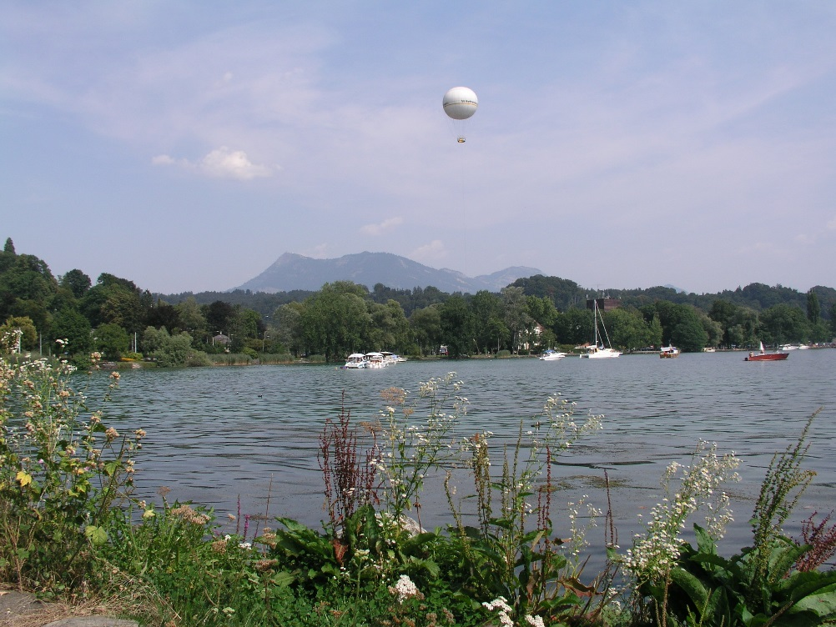
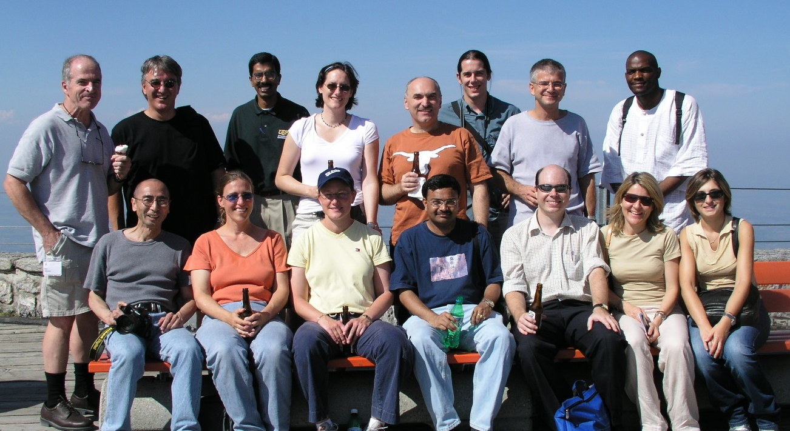
The last time I was in Switzerland?
IATBR, Lucerne, August 2003
Mt. Pilatus
Notes:
The other photos in this presentation are also from the 2003 Lucerne IATBR conference.

Slide 3
Motivation (1)
“Travel demand modelers can be classified into two kinds of people:
those who focus on the V, and
those who focus on the ε ”
Sergio Jara-Diaz (I think)
V: observed
ε: unobserved
}
influences on behavior
Notes:
Sergio J-D was also at the Lucerne conference, which is where this photo was taken, but it was on a different occasion that I heard him say the following (at least, I’m pretty sure it was he!):

Slide 4
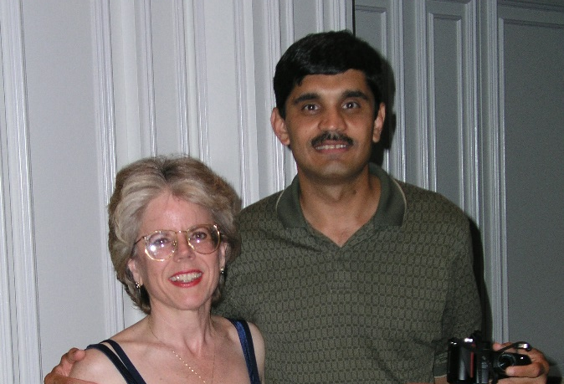
Motivation (2)
Now some of my best friends are ε people
And other best friends fit well into both groups
But I have to admit to being a V person
Notes:
For example, Frank Koppelman (who turned 80 yesterday, 5/16/2017), has certainly made important contributions in ε-world, but, in collaboration with marketing research colleagues at Northwestern in the late 1970s, he was also a pioneer in measuring attitudes and incorporating them into travel demand models.
A couple decades later, Joan Walker and others (including several in this room) were instrumental in developing and applying “hybrid choice models” or “integrated choice and latent variable (ICLV) models”, which involve simultaneous estimation of parameters associated with *both* the inclusion of attitudinal variables into the V *and* (potentially) sophisticated structures on the ε.
But as a student of Frank’s during that late-’70s era, I became attached to the philosophy that we should first and foremost try to get the V as good as we can. In other words, we should think deeply about the influences that are relevant to the behavior of interest, and do our best to measure those influences and include them in our models.

Slide 5
Motivation (3)
“[T]here is only so much random structure that can be extracted from things that we do not observe.”
Greene and Hensher (2007), p. 623
“In a deep sense, the ultimate goal of the researcher is to represent utility so well that the only remaining aspects constitute simply white noise.”
Train (2009), pp.35-36
Notes:
But it’s not just me saying this… Hensher, a pretty respectable ε person, admits that …
And Train goes even farther, saying, in effect, that we should aim to get the V so well-specified that the simplest possible assumptions about the ε (iid) will be valid.

Slide 6
Motivation (4)
“[V]ariables not included in conventional data sets, such as comfort, reliability and safety, can have important influences on mode choice.”
Horowitz (1991), p. 437
Notes:
From long ago (1991), it’s been observed that attitudes comprise an important portion of what’s usually falling into the ε.

Slide 7
Motivation (5)
Indeed, numerous studies have shown that when attitudes are included,
we explain more about behavior (e.g. Becker et al. 2017; Domarchi et al. 2008; Kuppam et al. 1999; Mokh­tarian and Salomon 1997)
and
we explain it differently (e.g. Handy et al. 2005; Cao et al. 2007; who found that when attitudes were included, the impact of the built environment on travel behavior diminished to negligibility; Vij & Walker 2016)
Notes:
Nuance: the Handy et al. (VMD) and Cao et al. (VO) studies found that *for the cross-sectional models*, no BE variables were significant once attitudes were included. Some BE variables remained in the *quasi-longitudinal* models, but appeared to play a more modest role than attitudes.

Slide 8
Motivation (6)
Thus, many travel behavior researchers need no convincing of the value of including attitudes in our models
But the evidence I’ve mentioned is based entirely on small(ish) samples of respondents to purpose-built surveys
What about the large-scale, in-practice regional travel demand forecasting (RTDF) models?
Notes:
What I’ve said so far is not particularly news.

Slide 9
Motivation (7)
There, of course, attitudes are nowhere to be found
Accordingly, such models are deficient in their ability to res­pond to changing con­ditions, as evidenced by their
typically-less-than-10% explanatory power,
need to have numerous parameters be judgmen-tally altered (“asserted”) during calibration, and
lack of sensitivity to changing societal values
And yet, they have never been more vital
Notes:
The calibration of such models is rife with judgmentally altered (“asserted”) parameters, re­quired for consistency with expectation or to improve performance. It is also obvious that these models are incapable of reflecting the influences of an in­creasingly pro-envir­onmental attitude, or one’s openness/resistance to new tech­no­lo­gies, on behavior -- fac­tors that are clearly relevant to forecasting the future demand for various types of travel, particularly in our era of rapid technological change.
“They” have never been more vital: “they” = both the models, and the attitudes missing from the models.

Slide 10
Motivation (8)
Unprecedented change in the
transportation “landscape”
technologies
societal shifts
policy/planning instruments
Uber, Lyft, car/bikesharing, etc.
long-range electric vehicles (Tesla, Zoe)
autonomous vehicles, drones
virtual reality “travel” experiences
delayed or de­ferred marriage and childbearing
greater education coupled with widespread under­em­ployment
increasing ethnic diver­sity
shifting values (e.g. more favorable toward tech­no­lo­gy, physical activity, and the en­vironment)
favoring denser, more diverse land uses
changing the rev­enue base away from fuel taxes
yet-to-be-determined policies toward AVs
Notes:
a wide variety of technologies that are already in-existence, in-development, and in-infancy (examples: emergence of ride-hailing companies such as Uber and Lyft, the commercialization of long-range electric vehicles such as Tesla, the entrance of autonomous vehicles and drones, and the development of virtual reality that will provide a nearly-true travel experience without traveling);
What is unknown is how all these technologies will alter our travel patterns, how they will change our physical landscape, and how we, as transportation professionals, should de­sign our future transportation system to improve mobility, accessibility and environ­men­tal sus­tain­ability.
Thus, it is more important than ever before to understand/ predict the behavioral impacts of these changes, and I suggest that understanding attitudes is central to our task.

Slide 11
Terminology (1)
By attitudes, I include
opin­ions,
feelings,
pre­fer­ences,
per­­ceptions,
lifestyle orientation, and
personality

Slide 12
Terminology (2)
E.g., attitudes toward
sharing vs. owning
multitasking
time pressure
privacy
materialism
physical activity
the environment
residential location
transit
self-efficacy
peer influence
risk taking
technology

Slide 13
So…
RTDF: regional travel demand forecasting
If attitudes are so great, why are they missing from RTDF models?
(Alleged) barriers to inclusion:
They’re difficult to measure/analyze
Additional burden on already difficult-to-recruit respondents
Require “atypical” skills to design/analyze
They’re impossible to forecast
Notes:
The data used to estimate the mo­dels are primarily obtained from re­gional or na­tional surveys, for which large num­bers of households are asked to pro­vide details on all trips made by each member of the house­hold over one or more days, to­gether with their socioecon­om­ic traits. Con­ven­tional wis­dom holds that it is a heavy enough burden on parti­cipating households to provide the minimally-necessary data, and it is already becoming more and more diffi­cult to re­cruit a representative sample of households willing to pro­vide such information. Ask­ing each member to respond to an additional battery of attitu­dinal questions appears to be a luxury we cannot afford.
The second barrier to the inclusion of attitudes is that we are unable to forecast them, in the way that we forecast socioeconomic variables. Without reliable forecasts of what atti­tudes will be like at some future planning horizon, predictions of behavior that require such attitudes as input must rely on guesswork.
The remainder of this talk will focus mainly on the measurement/analysis issue, but I will briefly return to the forecasting issue near the end.

Slide 14
Our challenge (1)
Can we incorporate into large-scale regional models the valuable information carried by attitudes, without adding (many) new questions to travel/activity diary surveys?
US DOT has recently funded a University Trans-portation Center to embark on this quest in a systematic way over the next 5 years
http://www.tomnet-utc.org/ (so far skeletal)

Slide 15
Our challenge (2)
Can we incorporate into large-scale regional models the valuable information carried by attitudes, without adding (many) new questions to travel/activity diary surveys?
A couple of ideas:
Use attitudes to “inform” coefficients in conventional models
Impute attitudes into (travel) behavioral datasets

Slide 16
1. Use attitudes to inform coefficients of typical variables
Falls under the research theme of transferability of model parameters, which has been extensively studied (Koppelman & Wilmot, 1982; Fox & Hess, 2010)
Sanko (2014) used repeated cross-sectional data to model commute mode choice coefficients as a function of time
Chingcuanco & Miller (2014) regressed time-varying constant and scale parameters of MNL VO models against employment rate, gas prices, etc.
But to my knowledge, we haven’t yet used attitudes to model parameters of regional models (although see Ramezani et al. in press; Abou-Zeid et al. 2011)
Notes:
Nagoya: “Behaviours in 2001 are forecast using a model with only the most recent 1991 dataset and models that combine the 1971, 1981, and 1991 datasets.” The latter predicts (commute mode choice, between rail, bus, car) better. Travel cost not included because some employers subsidize. Results showed disutility of travel time increasing (getting more negative) over time, which author attributed to increasing incomes/busy-ness. Alluded to possibility that disutility of time could decrease due to “modern technology mak[ing] travel time more productive”.
C & Miller, p. 942: “the proposed methodology would require the predictors themselves to be forecasted … In this case, however, the assumptions and models would be more consistent with each other. For instance, in forecast scenarios of high gas prices, both the parameters and inputs to the model might capture the effect of the increase in fuel prices on travel demand.”

Slide 17
An example: AV impacts on β_{TT}
AV: autonomous vehicle; TT: travel time
For a dataset containing attitudes, model
$V={β_{0}+β}_{TT}TT+β_{TC}TC+\sum_{k=1}^{K}{β_{k}{var}_{k}}$ ,
where
$β_{TT}=γ_{0}+\sum_{z=1}^{Z}{γ_{z}{soc}_{z}}+\sum_{t=1}^{T}{γ_{t}{att}_{t}}+ \sum_{m=1}^{M}{γ_{m}{MT}_{m}}$.
Malokin et al. (under review; in process)

Slide 18
Ex: AV impacts on β_{TT} (2)
AV: autonomous vehicle; TT: travel time
Once all parameters are estimated, we can, e.g.,
compute $β_{TT}$ for everyone in the sample
examine the (weighted) distribution of $β_{TT}$ across the full sample and by subgroup
analyze the factor by which multitasking discounts $β_{TT}$, namely $\sum_{m=1}^{M}{γ_{m}{MT}_{m}}$/$β_{TT}$.
This provides an empirical, rather than purely judgmental, basis for discounting $β_{TT}$ in a large-scale regional model, in order to simulate one impact of AVs

Slide 19
1. Use attitudes to inform coefficients of typical variables
In summary, to apply this method we can
collect attitudinal and behavioral data on a relatively small, but (weighted to be) representative, sample;
use that sample to estimate our “conventional” model;
analyze the influence of attitudes on the coefficients of the conventional model; and
transfer basic insights gained, over to simulations based on the large-scale model

Slide 20
2. Impute attitudes into large behavioral dataset
Think NHTS (US), NTS (UK etc.), but if this works, it can be applied to large-scale datasets measuring
time use (ATUS)
residential energy consumption (RECS)
consumer expenditure (CES)
physical activity (NHANES, BRFSS,…)
etc….

Slide 21
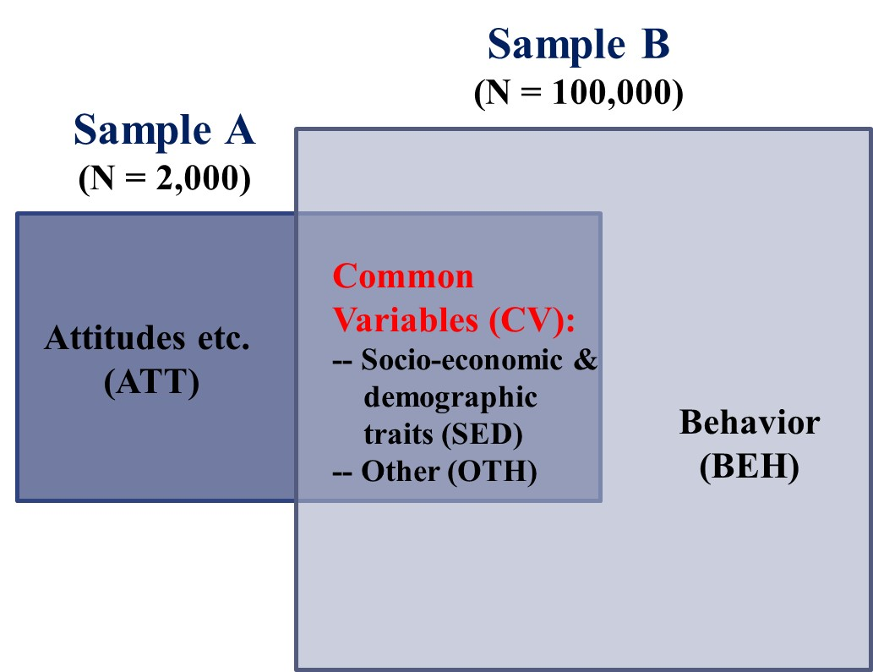
2. Impute attitudes (2)
Using a set of explana-tory variables present in (common to) both samples (CVs),
develop prediction functions for attitudes (ATTs) using “Sample A(tt)” and
apply those functions to predict ATTs for
“Sample B(eh)”

Slide 22
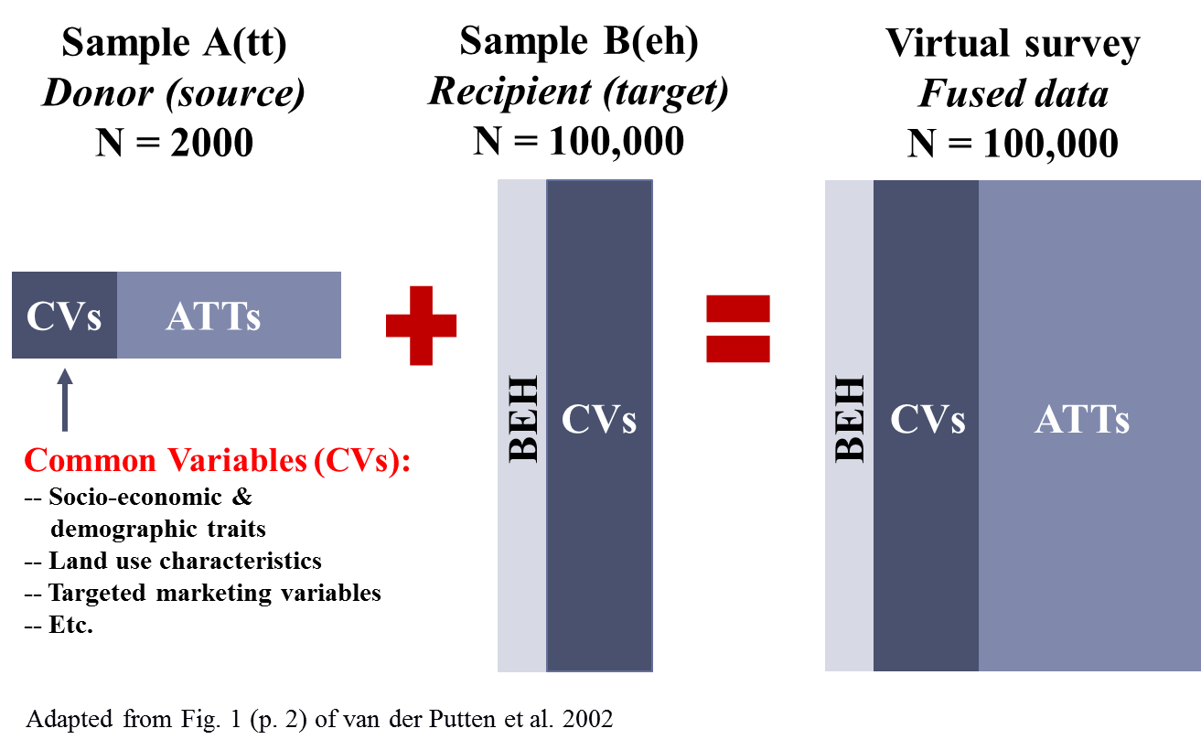
2. Impute attitudes (2)
Notes:
Using a set of explanatory variables present in (common to) both samples (CVs),
-- develop prediction functions for attitudes (ATTs) using “Sample A(tt)” and
-- apply those functions to predict ATTs for “Sample B(eh)”

Slide 23
Sample A(tt)
Donor (source)
N = 2000
Sample B(eh)
Recipient (target)
N = 100,000
Virtual survey
Fused data
N = 100,000
CVs
ATTs
BEH
CVs
BEH
CVs
ATTs
Common Variables (CVs):
-- Socio-economic &
demographic traits
-- Land use characteristics
-- Targeted marketing variables
-- Etc.
Adapted from Fig. 1 (p. 2) of van der Putten et al. 2002

Slide 24
2. Impute attitudes (3)
Uh… that’s been tried… And such models are lousy at predicting attitudes (typical R²s < 0.1)
True! But that’s when
only SED variables are used as predictors (what if we add LU and other variables?); and
one-size-fits-all coefficients are estimated (what if we get fancier with segmentation?)
Spears et al. (2013)
Notes:
Our approach does not focus on trying to produce a causally-defensible model for predicting attitudes, since that is not our purpose. Rather, to maxi­mize the information available to impute attitudes, we want to use the largest set of variables that is (1) related to attitudes at all, and (2) common to both samples.

Slide 25
Machine learning to the rescue?
decision trees & random forests (cluster specifically so as to maxi­mize within-cluster homo­geneity on the target attitude)
k-nearest neighbor
least absolute shrinkage selection operator (LASSO) regression
adaptive boosting
support vector machines, etc…
… offer ways of imputing attitudes to Sample B
Wu & Kumar (2009)
Notes:
All characterized by testing large numbers of specifications on a training sample, then applying them to a validation sample (both subsets of Sample A), while balancing the competing objectives of reducing bias (by fitting a more complex model to the training sample, which could result in overfitting) and reducing variance (referring to the difference between predicted and observed variables in the validation sample(s), which tends to be larger when the model is overfit).

Slide 26
Proof-of-concept work in progress
Sample A (N=2,352):
2011 survey of Northern California commuters
14 pp. survey, including measurement of numerous attitudes, behavior with respect to recent commute, and sociodemographic traits
Sample B (N=64,412):
2009 US National Household Travel Survey (NHTS)
One-day travel diary, sociodemographic traits, almost no attitudinal questions
Randomly selected one driving-age person per HH, since the unit of observation for Sample A is the indiv.

Slide 27
Our mission
Using machine-learning methods, impute ATTs from Sample A to Sample B
Estimate a travel behavior (TB) model without and with ATTs, to assess value added
We chose vehicle ownership (VO) as the TB of interest, since we could model that on both samples and compare

Slide 28
At least two key questions of interest
How well do we impute ATTs – to their “own” (source) sample?
How much explanatory power do the imputed ATTs add to the TB model on the target sample?

Slide 29
1. How well do we impute ATTs?
Sample A (N=2,352):
The pool of variables common to both surveys was augmented with numerous land use variables from external sources
LASSO regression (with 10-fold cross-validation) reduced mean-squared error in prediction of (the 3 best) ATTs by 22-26% compared to using the mean
Correlations between observed and predicted:
pro-transit: 0.546
pro-active transportation: 0.540
pro-density: 0.567
Variable | random hot deck | average | lasso regression
pro-transit | 2.021 | 0.993 | 0.757
pro-active transp | 2.009 | 1.009 | 0.789
pro-density | 1.970 | 1.005 | 0.748
Notes:
The penalty term for Least Absolute Shrinkage and Selection Operator (LASSO) regression, $−λ\sum_{j=1}^{p}{{\left|β\right|}_{j}}$ (where $β_{j}$ are parameters, $p$ is # of params, and $λ$ is shrinkage operator), is estimated simultaneously with the model and prevents the large coefficient magnitudes that are common in the presence of multicollinearity (i.e., it shrinks the coefficient magnitudes toward zero); however, its non-linear nature allows LASSO to take the best of both discrete and continuous methods: by allowing some coefficients to shrink to zero (unlike ridge regression), it can effectively perform subset selection as well as shrinkage (Hastie et al., 2009).
The noted correlations between predicted and “actual” attitudes are far from perfect, but I suggest they are better than the correlations between most instrumental variables and the endogenous explanatory variable they are supposed to be instrumenting!

Slide 30
1. How well do we impute ATTs?
Sample A (N=2,352):
The pool of variables common to both surveys was augmented with numerous land use variables from external sources
LASSO regression (with 10-fold cross-validation) reduced mean-squared error in prediction of (the 3 best) ATTs by 22-26% compared to using the mean
Correlations between observed and predicted:
pro-transit: 0.546
pro-active transportation: 0.540
pro-density: 0.567
Notes:
The penalty term for Least Absolute Shrinkage and Selection Operator (LASSO) regression, $−λ\sum_{j=1}^{p}{{\left|β\right|}_{j}}$ (where $β_{j}$ are parameters, $p$ is # of params, and $λ$ is shrinkage operator), is estimated simultaneously with the model and prevents the large coefficient magnitudes that are common in the presence of multicollinearity (i.e., it shrinks the coefficient magnitudes toward zero); however, its non-linear nature allows LASSO to take the best of both discrete and continuous methods: by allowing some coefficients to shrink to zero (unlike ridge regression), it can effectively perform subset selection as well as shrinkage (Hastie et al., 2009).
The noted correlations between predicted and “actual” attitudes are far from perfect, but I suggest they are better than the correlations between most instrumental variables and the endogenous explanatory variable they are supposed to be instrumenting!

Slide 31
2. How much explanatory power do the imputed ATTs add?
Results are modest:
Two of the three imputed attitudes are significant, with expected signs, but
the model “lift” from the new variables is small ($\overline{R^{2}}$ increased from 0.385 to 0.389)
However:
Our dependent variable (vehicle ownership) may not depend much on attitudes (in most of the US)
We have a few more things to try

Slide 32
 | Sam-ple | ATTs | Specifi-cation | Rationale
1 | A | “Observed” | Best | Benchmark
2 | A | None | Same as 1, exc. w/o ATTs | See how much explanatory power the “true” ATTs have
3 | A | Predicted | Same as 1 | Assess how much GOF of benchmark model degrades when only imput­ed ATTs are avail­able
4 | A | Predicted | Best new | Assess how different a model might be from the benchmark, when only im­puted ATTs are available and the specification of the “true” model is unknown
5 | B | Imputed | Same as 1 | Assess how well imputed ATTs allow recovery of the “true” model
6 | B | Imputed | Best new | Same as for 4
7 | B | None | Same as 6, exc. w/o ATTs | See how much explanatory power even “noisily” estimated ATTs have

Slide 33
 | Sam-ple | ATTs | Specifi-cation | $$\overline{R^{2}}$$ | Comments
1 | A | “Obs” | Best | .454 | All 3 ATTs significant with negative coeffs
2 | A | None | Same as 1, exc. w/o ATTs | .421 | 7% drop in $\overline{R^{2}}$ without ATTs (or 8% increase with ATTs)
3 | A | Pred | Same as 1 | .456 | Pred. ATTs do slightly better than obs. ones! Pro-active transp (+1) becomes insignificant
4 | A | Pred | Best new | .457 | Pro-active transp still insignificant Lose 3, gain 2 vars compared to #3
5 | B | Im-puted | Same as 1 | .385 | Pro-transit (+1) marginal, 3 others insignif. 15% drop in $\overline{R^{2}}$ compared to #1
6 | B | Im-puted | Best new | .389 | Pro-transit now insignificant
7 | B | None | Same as 6, exc. w/o ATTs | .385 | Only a 1% drop in $\overline{R^{2}}$ without ATTs (or 1% increase – “model lift” – with ATTs)
Notes:
#5: Considering that a model fit to a Northern California sample is being used on a nationwide sample, a 15% drop in adj. R2 doesn’t seem too bad.
#7: If ATTs largely determined by the other variables in the model, then when ATTs removed, the other variables may pick up nearly all of the slack.

Slide 34
Some potential problems
There may be mismatch between (imputed) ATTs and (reported) BEH for some (many) cases, in which case ATTs may not appear to explain BEH very well (an example of the attenuation of estimated effects caused by measurement error; e.g. Cameron and Trivedi, 2005)
Will we induce circularity?
E.g., using mode choice to predict ATTs and then those ATTs to predict mode choice
Using LU vars to predict ATTs, then including both ATTs and LU vars in the model
Notes:
The first one doesn’t seem to be *much* of a problem for us, since the imputed ATTs *were* mostly significant in the models.
(For sure there will be measurement error in the imputed ATTs, but guess what – there is for TT, for example, too… The question for me is whether will be enough “signal”, despite the “noise”, to make this approach useful).

Slide 35
Looking to the future… (1)
Addition of just a few new CVs to Sample B might considerably improve our ability to impute ATTs
Notes:
The idea of creating attitudes entirely “from scratch” may well be too ambitious! But…

Slide 36
The “Golden Questions”
Q1: Have you driven a car or van in the past 12 months?
Q2: For most journeys, I would rather use the car than any other form of transport
Q3: I like to drive just for the fun of it
Q4: I am not interested in reducing my car use
Q5: Driving gives me a way to express myself
Q6: How likely are you to drive in the next 12 months?
Q7: I am not the kind of person who rides a bicycle
Q8: I feel I should cycle more to keep fit
Q9: I find cycling stressful
Q10: Cycling can be the quickest way to travel around
Q11: I like travelling by bicycle
Q12: I am not the kind of person that likes to walk a lot
Q13: I feel I should walk more to keep fit
Q14: I like travelling by walking
Q15: I am not the kind of person to use the public transportation
Q16: In general, I would rather cycle than use the bus
Q17: I feel a moral obligation to reduce my emissions of greenhouse gases
Q18: People should be allowed to use their cars as much as they like
Anable and Wright (2013)

Slide 37
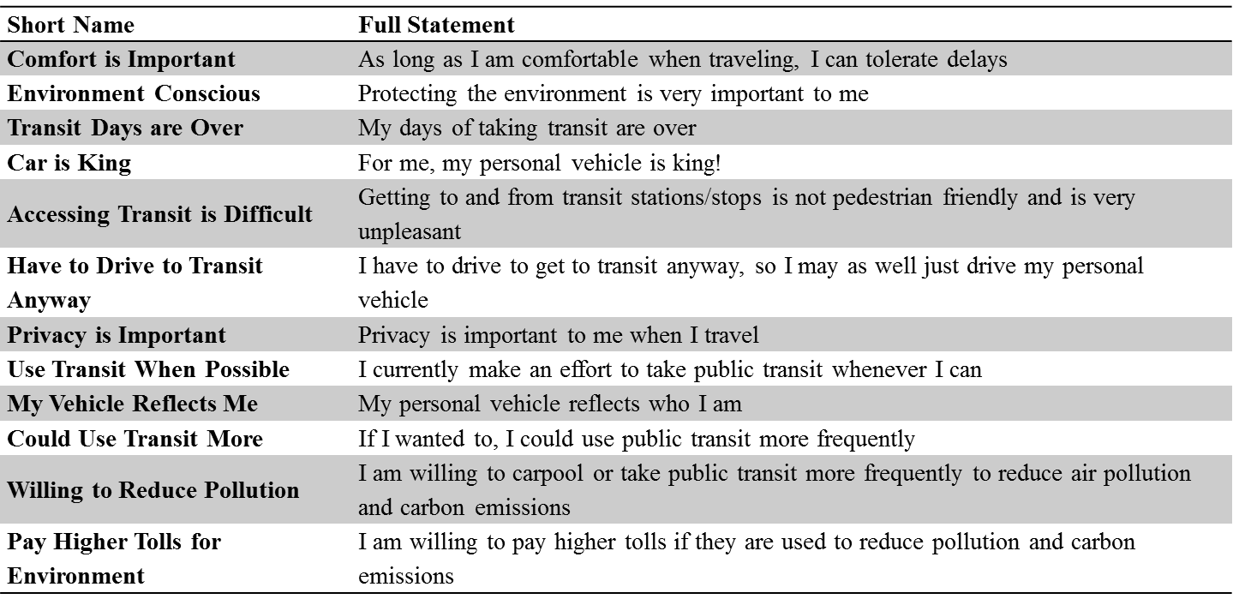
Or the “RSG 18” (1)
RSG: Resource Systems Group
Here are 12:

Slide 38
Or the “RSG 18” (2)
RSG: Resource Systems Group
And the other 6:
Short Name | Full Statement
Not Afraid of Transit | I am not afraid to ride transit
Transit Oriented | I’m the kind of person who rides transit
Transit is Easy | It’s easy to plan a trip using transit
Transit is Dirty | Transit is often dirty
Productivity is Important | More than saving time, I prefer to be productive
Change Mode to Save Time | If it would save time, I would change my form of travel

Slide 39
Looking to the future… (2)
And about forecasting ATTs…
We could start with monitoring them over time, via panels and repeated cross-sections…
… allowing us to identify patterns in how they change over time
… eventually leading to models of formation and change
Big Data could help – e.g. social media postings
Targeted marketing databases might contribute
Notes:
-- Which new CVs will help most will differ by domain
-- “big data” (such as social media postings) from communica­tions and computation technolo­gies will not only allow us to incorporate attitudinal vari­ables into regional travel demand forecasting models, but also afford us an unprece­dented opportunity to truly under­stand how people’s attitudes are formed and connected to their surroundings and how certain attitudes may be influenced toward promoting more sustainable behaviors.

Slide 40
Conclusions
Have suggested some ways to use attitudes obtained from smaller separate samples to inform models estimated on large-scale behavioral datasets
Although there’s lots of room for improvement, it looks like at least modest gains in
“goodness”
behavioral realism
responsiveness to important variables
of our models can be achieved by incorporating
attitudinal variables
Seems like a path worth traveling a bit farther!
Notes:
I hope this will help stimulate some new ideas from you, and I look forward to seeing what we can learn together from this direction.

Slide 41
Selected references (1)
Abou-Zeid M, M Ben-Akiva, M Bierlaire, C Choudhury, S Hess (2011) Attitudes and value of time heterogeneity. Paper 11-0478 presented at the 90th Annual Meeting of the Transportation Research Board, Washington, D.C., January 23-27.
Anable J, S Wright (2013) Segment. <http://www.segmentproject.eu/hounslow/segment.nsf/Files/SFF-266/$file/Deliverable%207.8.4%20GOLDEN%20QUESTIONS%20AND%20SOCIAL%20MARKETING%20GUIDANCE%20REPORT.pdf>
Becker H, A Loder & KW Axhausen (2017) Modeling car-sharing membership as a mobility tool: A multivariate probit approach with latent variables. Travel Behaviour and Society 8, 26-36.
Cameron AC & PK Trivedi (2005) Microeconometrics: Methods and Applica­tions. New York: Cambridge University Press.
Cao X, PL Mokhtarian & SL Handy (2007) Cross-sectional and quasi-panel explorations of the connection between the built environment and auto ownership. Environment & Planning A 39, 830-847.
Chingcuanco F & EJ Miller (2014) A meta-model of vehicle ownership choice parameters. Transportation 41(5), 923-945.
Domarchi C, A Tudela & A Gonzalez (2008) Effect of attitudes, habit and affective appraisal on mode choice: An application to university workers. Transportation 35(5), 585-599.

Slide 42
Selected references (2)
Fox J & S Hess (2010) A review of the evidence for the temporal transferability of mode-destination models. Transportation Research Record 2175, 74-83.
Greene WH & DA Hensher (2007) Heteroscedastic control for random coefficients and error components in mixed logit. Transportation Research Part E 43, 610-623.
Handy SL, X Cao & PL Mokhtarian (2005) Correlation or causality between the built environment and travel behavior? Evidence from Northern California. Transportation Research D 10, 427-444.
Horowitz JL (1991) Reconsidering the multinomial probit model. Transportation Research B 25, 433-438.
Koppelman FS & C Wilmot (1982) Transferability analysis of disaggregate choice models. Transportation Research Record 895, 18-24.
Kuppam AR, RM Pendyala & S Rahman (1999) Analysis of the role of traveler attitudes and perceptions in explaining mode-choice behavior. Transportation Research Record 1676, 68-76.
Malokin A, G Circella & PL Mokhtarian (under review) How do activities conducted while commuting influence mode choice? Testing transit-advantage and autonomous-vehicle scenarios.
Malokin A, G Circella & PL Mokhtarian (in preparation) Do millennials value travel time differently? A segmented mode choice model accounting for travel-based multitasking. Presented at 2017 Annual TRB Meeting.

Slide 43
Selected references (3)
Mokhtarian PL & I Salomon (1997) Modeling the desire to telecommute: The importance of attitudinal factors in behavioral models. Transportation Research A 31(1), 35-50.
Outwater ML, S Castleberry, Y Shiftan, M Ben-Akiva, YS Zhou & A Kuppam (2003) Use of structural equation modeling for an attitudinal market segmentation approach to mode choice and ridership forecasting. Presented at the 10th International Conference on Travel Behaviour Research, Lucerne, Switzerland.
Sanko N (2014) Travel demand forecasts improved by using cross-sectional data from multiple time points. Transportation 41(4), 673-695.
Spears S, D Houston & MG Boarnet (2013) Illuminating the unseen in transit use: A framework for examining the effect of attitudes and perceptions on travel behavior. Transportation Research A 58, 40-53.
Steg L, K Geurs & M Ras (2001) The effects of motivational factors on car use: A multidisciplinary modelling approach. Transportation Research A 35(9), 789–806.
Train K (2009) Discrete Choice Methods with Simulation. Cambridge University Press. Available at http://eml.berkeley.edu//~train/distant.html.
van der Putten P, JN Kok & A Gupta (2002) Data fusion through statistical matching. Paper 185, Center for eBusiness @ MIT (or MIT Sloan Working Paper No. 4342-02). Available at https://papers.ssrn.com/sol3/papers.cfm?abstract_id=297501, accessed April 10, 2017.

Slide 44
Selected references (4)
Vij A & J Walker (2016) How, when and why integrated choice and latent variable models are latently useful. Transportation Research B 90, 192-217.
Wu X & V Kumar (2009) The Top Ten Algorithms in Data Mining. Boca Raton, FL: Chapman & Hall/CRC.
www.images.google.com (“attitude”), accessed October 21, 2016

Slide 45
Ram Pendyala, Dir
Deborah Salon
Sara Khoeini
Abdul Pinjari
Fred Mannering
Cynthia Chen
Pat Mokhtarian, Research Dir
Alex Karner
Giovanni Circella

